Slide 1

Software Project Management: A Comprehensive Guide
This presentation will guide you through the key elements of successful software project management. We will cover the fundamental areas of project planning, execution, and control. This framework will ensure your projects are delivered on time, within budget, and meet high quality standards.
B.SWATHI
Bsc.CS(III)

Slide 2
Scope Management
Defining the Project Scope
Scope Creep Prevention
Scope Verification
Clearly outlining the project's objectives, deliverables, and boundaries is essential for success. Ensure everyone understands what's included and what's not.
Prevent scope creep by managing changes effectively. Establish a change management process and ensure all changes are documented and approved.
Regularly review and confirm that the project's scope remains aligned with the original plan and meets the stakeholders' needs.

Slide 3

Time Management
1
Planning and Scheduling
Create a detailed schedule with clear deadlines and milestones. Use project management tools to help track progress and allocate resources effectively.
2
Monitoring and Control
Continuously monitor progress against the schedule. Identify potential delays and take corrective action to keep the project on track.
3
Task Management
Break down large tasks into smaller, manageable units. Assign tasks to team members and ensure they have the necessary resources and support.

Slide 4

Cost Management
Cost Estimation
Cost Control
Develop accurate cost estimates based on historical data, industry standards, and team expertise. This ensures a realistic budget for the project.
Monitor project expenses carefully and track spending against the budget. Implement cost-saving measures as needed to stay within budget.
Budget Management
Regularly review and adjust the budget as needed based on project progress and any unforeseen circumstances. Ensure transparency and communication.

Slide 5

Quality Management
1
Quality Planning
2
Quality Assurance
3
Quality Control
Establish clear quality standards and metrics. Define a quality management plan to ensure high-quality deliverables.
Implement quality assurance processes throughout the project lifecycle. Conduct regular reviews and testing to identify and fix defects early.
Monitor quality throughout the project. Ensure that all deliverables meet the agreed-upon quality standards and specifications.

Slide 6
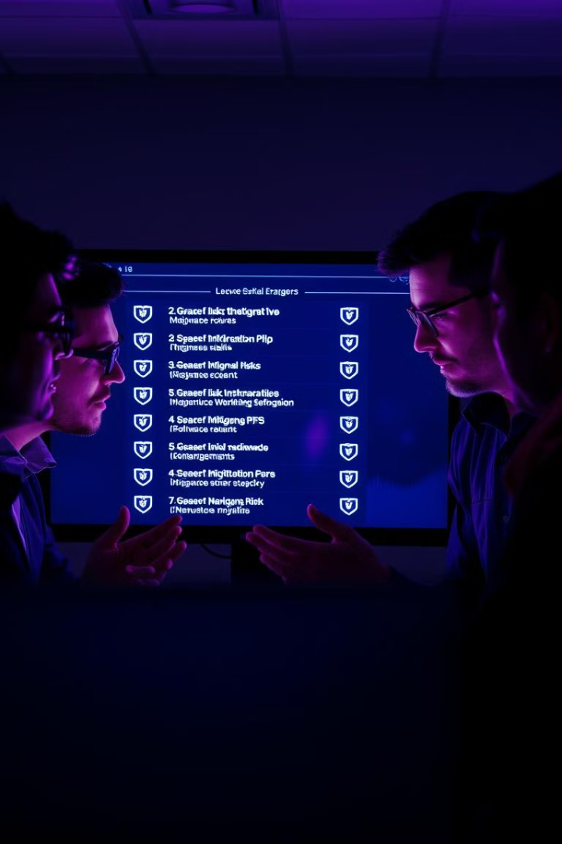
Risk Management
Identify Risks
Assess the likelihood and impact of potential risks that could affect the project.
Plan Mitigation Strategies
Develop and document strategies to minimize the impact of identified risks.
Monitor and Control Risks
Continuously track risks and adjust mitigation strategies as needed.

Slide 7




Stakeholder Management
Identify Stakeholders
Identify all individuals or groups who have an interest in the project.
Communicate Effectively
Maintain open and transparent communication with all stakeholders.
Manage Expectations
Set realistic expectations and keep stakeholders informed about project progress.

Slide 8




Project Closure and Lessons Learned
Formal Closure
Document the project's completion, including a final report and a summary of key outcomes.
Lessons Learned
Analyze project performance to identify areas for improvement in future projects.
Project Review
Conduct a post-project review with stakeholders to gather feedback and acknowledge contributions.

Slide 9

Thank You
We hope this presentation has provided you with a valuable overview of software project management. We encourage you to use these principles and best practices to guide your own project success.

